Slide 1
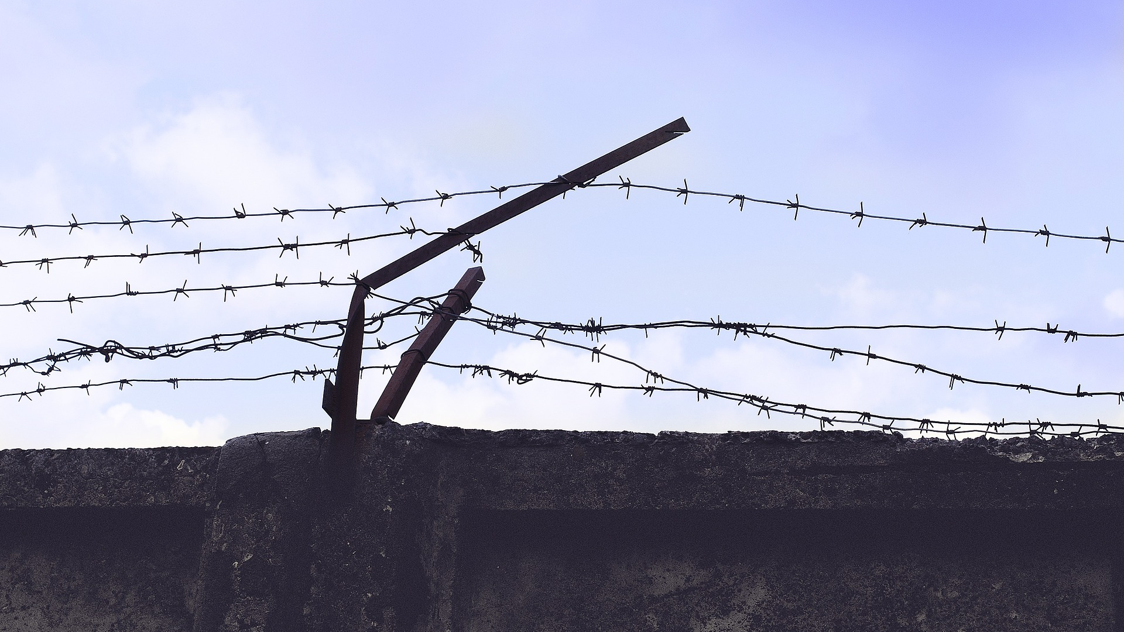
AN ARTIST’S RESPONSIBILITY?
BQ2 Values Lesson 8
I can offer an opinion on whether it is an artist’s responsibility to confront moral issues in their work
Notes:
See how this lesson links to the course by viewing the final slide
Key TOK terms appear in a red font

Slide 2
Starter
Make a list of some works of art that have dealt with moral issues or principles - not including the examples we have seen over the last few lessons.
This writer could definitely be mentioned...
Notes:
Gather answers - discuss the theme of ones mentioned, and how they shape our moral awareness (or not).
The picture shows, of course, George Orwell - worthy of discussion in his own right (Nineteen Eighty-Four, Animal Farm, Homage to Catalonia, Down and Out in Paris and London, etc.)

Slide 3
Opinion 1
Ai Weiwei, Chinese artist and dissident:
“An artist must also be an activist – aesthetically, morally, or philosophically. That doesn’t mean they have to demonstrate in street protests, but rather deal with these issues through a so-called artistic language. Without that kind of consciousness – to be blind to human struggle – one cannot even be called an artist.”
Notes:
See March 2020 interview with Ai Weiwei here (this is his answer Jude Kelly’s question, “If artists aren’t active in the political space, do you think that they are essentially supporting the status quo?”
Image of the Beijing Olympic stadium, designed by Weiwei

Slide 4
Opinion 2
British journalist, Rachel Cooke:
“The idea of 'ethical art' is nonsense. We have to separate art from life… It's baffling to me, the belief that art must be "ethical", as if it were so much fair trade chocolate.”
Notes:
This opinion is found in this 2013 article here.

Slide 5
Is it an artist’s responsibility to confront moral issues?
Think of arguments and evidence to support both opinions.
Draw on the work we have done over the last couple of lessons, and the examples we have looked at.
Be ready to present your ideas on a 3-slide presentation.
Notes:
See also Barbara Kingsolver article here. Her work includes the book The Poisonwood Bible, which dealt with Belgian atrocities during their colonial control of The Congo.

Slide 6
Links to the TOK exhibition
Related exhibition prompt Can new knowledge change established values or beliefs (IAP-11)?
Refer to the ideas from this lesson to answer this question.
For example, how can new artistic ideas change the way we view ethical issues? To what extent are our moral beliefs influenced by the arts?
Think about objects which might help to illustrate your answer.
Notes:
Optional slide, if you want to help students to take ownership of the IA prompts (IAPs) for the TOK exhibition
Note that the IB recommends using the core and/or optional themes as the context of the exhibition commentary, whereas this lesson deals more with areas of knowledge (the arts)

Slide 7
Exit
Do artists have a responsibility to confront moral issues in their work?
Do they deserve more praise if they do?
Notes:
See the BQ2 assessment tracker for suggestions on providing feedback, and recording students’ progress

Slide 8
Linking this lesson to the course
During this lesson, we consider the highlighted aspects of the TOK course
The images used in the presentation slides can also give students ideas about selecting exhibition objects; see also our link below to a specific IA prompt
CORE THEME | OPTIONAL THEMES | AREAS OF KNOWLEDGE | TOK ASSESSMENT
Knowledge & the knower | Indigenous societies | The arts | The TOK essay
 | Language | History
 | Politics | The human sciences | The TOK exhibition Could be linked to IAP-11 (beliefs), IAP-27 (obligations), IAP-35 (values)
 | Religion | Mathematics
 | Technology | The natural sciences

Slide 9
Explore the TOK themes and areas of knowledge in more depth via a range of thinkers, media sources, and other resources, in our EXPLORATION POINTS DOCUMENTS.
Access the documents via the links below. You’ll also find the EP icons on all of the TOK course pages of the site to help you unpack the quotes, KQs, and real-life situations that you find there.
CORE THEME
Knowledge & the knower
OPTIONAL THEMES
Indigenous societies
Language
Politics
Religion
Technology
AREAS OF KNOWLEDGE
The arts
History
Human sciences
Mathematics
Natural sciences
Notes:
Use this slide to access the ‘Exploration Points’ notes for BQ2, which will help students to develop a deeper knowledge of any TOK theme or area of knowledge. This will not only help them to master the TOK course in general, but also craft a great exhibition or essay.
Be ready to provide more guidance on how to use this resource - ie, which media sources to focus on, which questions to address, which TED talks to watch, and which key terms and ideas to understand.

